Slide 1
Inspired Conference
Putting data and analytics at the heart of your People decisions
Date: Wednesday 7th June 2017
Presenters: David Balls (Human Resources Director – Grosvenor Casinos)
Andrew Marritt (Owner – OrganisationalView)

Slide 2
“Find that individual story. There’s such a richness of data, and the longer that we work with that data, the quicker we’ll discover that richness.”
Steven G. Cochrane, Managing Director, Moody’s Analytics
Notes:
Introductions
Welcome to the session – say about 20 minutes presenting and then 10 minutes for questions
Who are we? Why listen to us? If we do not know we are talking about you could all be spending your time much better…..

Slide 3


Who are we?
David Balls
Human Resources Director (HRD) of Grosvenor Casinos, previously having held the same position within Equifax UK&I, a large US based consumer credit reporting agency, and TDX, a debt liquidation data and advisory solutions provider.
An interest in applying analytics to address people related issues has its’ foundations in his academic background, including an honours degree in Psychology (University of York) and a Masters degree in Occupational Psychology (University of London – Birkbeck College).
David is also a member of the British Psychological Society (BPS) and a Fellow of the Chartered Institute of Personnel and Development (FCIPD).
Andrew Marritt
Founder of OrganizationView, one of the earliest European People Analytics firms.
Practitioner – deep technology, statistics and HR knowlege
Regular HR Analytics conference chair
Member of CiPD advisory group for HR Analytics
Teaches HR analytics to senior HR leaders
Before OrganizationView part of global HR Management team Alstom Power

Slide 4
What are we here for?
Grosvenor Casinos
  So what was the issue?
  Re-adapt how to conduct HR
Data-driven HR
Getting started
Questions
Notes:
Overview of the session:
Big data is driven by analytics, the question is what are you really looking for and how does this impact on operational practice? What are people really doing with data day-to-day? What technology helps in the process, and how is analytics being used to aid decision making and strategy? How much is hype and how much is reality?
In this session I will speak a little about Grosvenor Casinos and some of its’ challenges and how we addressed them, AND then I will pass over to Andrew who will give you some insight into how you can make the same sorts of transitions we are making as a business….where to start and what to do etc….

Slide 5
Grosvenor Casinos
Key facts
Established | 1970
Clubs* | 58 (56 in UK; 2 in Belgium)
Venues
Revenue* | £408.1m
Operating profit* | £60.9m
Customer visits* | 8.2 million per year
Total spend per visit* | £50.02
Customers* | 1.6 million
Digital
Revenue* | £30.5m
Operating profit* | £5.3m
Customer visits* | 839 thousand per year
Total spend per visit* | £36.35
Customers* | 101 thousand

Slide 6

So what was the issue?
Notes:
The issue was that as an HR function we were very administratively focused…..we produced stuff! AND not that good stuff…..basic Human Resources Information System and a lot of spread sheets!
So the key issues:
We were producing data not insights – we could tell you how many people were leaving and possibly why BUT NOT how many had were rated as high performers / potentials at their last review? How many had recently moved role? How many had maybe reached a trigger point in terms of length of service? etc…
We were treating everything (one) is the same – we were not thinking about employment and engagement as a personalised experience and this stuff matters!
- 1994 (HBR) seminal paper entitled “Putting the Service-Profit Chain to Work”…brought together FOR THE FIRST TIME two facts that we always knew:
(1) Satisfied, loyal customers drive business growth and profitability
(2) Satisfied, loyal employees are more productive and deliver better service
Engage and enable employees…guess what….
(1) increase performance by 40%
(2) increase customer satisfaction by 18%
(3) decrease employee turnover by 14%
(4) 37% less absenteeism
(5) 50% will post pictures, messages and images on social media
(6) 33% will share positive unsolicited feedback
- Now we see five generations in the workplace and we need to cater for them all. In 2000 there were 11.2m under age of 15 and now that is expected to be 8.7m by 2040 (we are getting older)…..people aged 60+ already outnumber under 16s for the first time
(3) So it is about segmentation and identifying those groups that need attention – we need to know what are the primary motivators and needs of our key people.
We were treating everything (one) is the same – we were not thinking about employment and engagement as a personalised experience and this stuff matters! Creating personalised experiences is essential and they must be engaged in the process as this is all about your Employer Value Proposition (EVP).

Slide 7
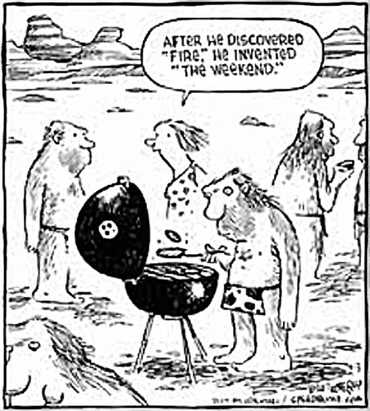
Readapt how to conduct HR
Notes:
The change:
We had to readapt how we conducted HR.
Move from gut-feeling to decisions being made on data – we have so much of it
We have started asking the right questions and using the insights to drive the decisions
But we are sensitive to the unintended consequences
EXAMPLE - Employee Segmentation and Engagement (across Rank):
PRIDE project (People, Recruitment, Inclusion, Diversity, Engagement)…..7.8% of the workforce were involved.
Segmented the workforce into 5 groups:
The Balancers: 33%
The Progressors: 20%
The Essential Seekers: 20%
The Friends: 19%
The Believers: 14%
- SAY SOMETHING ABOUT EACH OF THEM…..BUT CREATED THE STRAP LINE: “Where Everyone Counts”
- Now implementing interventions that appeal to each of theses groups
BUT we are at the start of our journey…..we need to work with people like Andrew to continually to review and really harness the value of data and analytics.
HAND OVER TO ANDREW SO THAT HE CAN SPEAK ABOUT HOW TO MOVE YOUR OWN HR FUNCION CAN MAKE THE TRANSITION AND WHAT TO THINK ABOUT

Slide 8
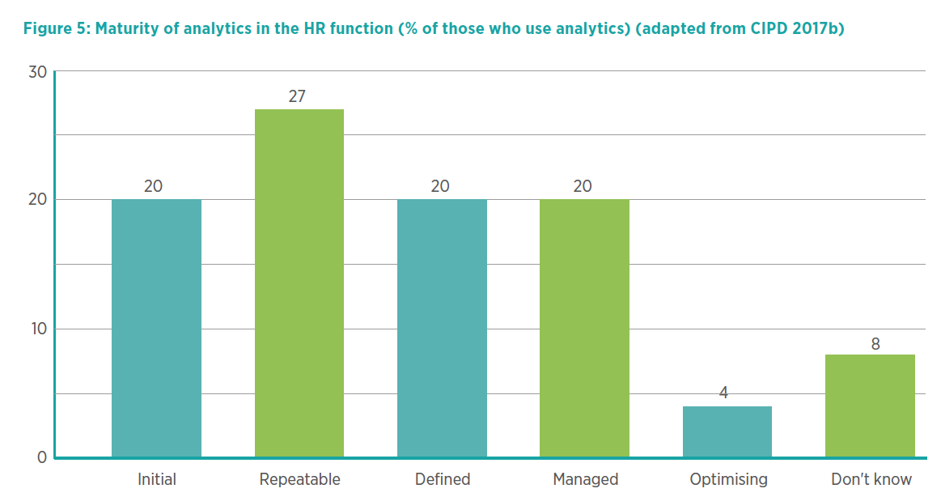
HR transitioning to maturity
Notes:
• Initial: HR teams answer oneoff
queries as and when they
happen, or to ‘fix’ something
with HR data, but no process is
documented. The terms analytics
or data probably aren’t used,
and there are no specific data or
analytics capabilities embedded
in HR teams.
• Repeatable: HR teams have
a process in place to run
analytics, and document queries
so they can be repeated. No
specific analyst role exists; it
is something that is done by
members of the HR team.
• Defined: HR analytics is a role
and/or activity in the HR team,
and the process of developing
and running analytics is well
documented and standardised.
There aren’t standardised metrics
across the business, but HR
is able to use its own data to
answer queries and run analytics.
• Managed: HR analytics team has
developed standard measures
and metrics which have been
agreed internally. A management
and governance role is in place
to ensure that analytics is
business-focused and robust.
• Optimising: analytics is
increasingly predictive, and is
being used to inform both HR
and business strategy, including
the optimisation of business
and people/HR processes. HR
data is used to drive

Slide 9
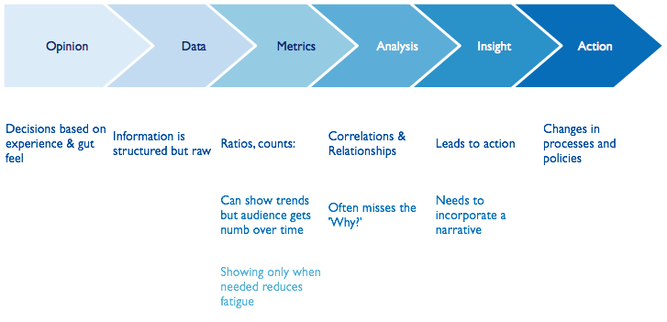
Notes:
The change:
We had to readapt how we conducted HR….Andrew has supported us with this:
Move from gut-feeling to decisions being made on data – we have so much of it
We have started asking the right questions and using the insights to drive the decisions
But we are sensitive to the unintended consequences
EXAMPLE - Employee Segmentation and Engagement (across Rank):
PRIDE project (People, Recruitment, Inclusion, Diversity, Engagement)…..7.8% of the workforce were involved.
Segmented the workforce into 5 groups:
The Balancers: 33%
The Progressors: 20%
The Essential Seekers: 20%
The Friends: 19%
The Believers: 14%
- SAY SOMETHING ABOUT EACH OF THEM…..BUT CREATED THE STRAP LINE: “Where Everyone Counts”
- Now implementing interventions that appeal to each of theses groups
BUT we are at the start of our journey…..we need to work with people like Andrew to continually to review and really harness the value of data and analytics
HAND OVER TO ANDREW SO THAT HE CAN SPEAK ABOUT HOW TO MOVE YOUR OWN HR FUNCION CAN MAKE THE TRANSITION AND WHAT TO THINK ABOUT

Slide 10
“When you have eliminated all which is impossible, then whatever remains, however improbable, must be the truth.”
Arthur Conan Doyle, The Case-Book of Sherlock Holmes
Notes:
The change:
We had to readapt how we conducted HR….Andrew has supported us with this:
Move from gut-feeling to decisions being made on data – we have so much of it
We have started asking the right questions and using the insights to drive the decisions
But we are sensitive to the unintended consequences
EXAMPLE - Employee Segmentation and Engagement (across Rank):
PRIDE project (People, Recruitment, Inclusion, Diversity, Engagement)…..7.8% of the workforce were involved.
Segmented the workforce into 5 groups:
The Balancers: 33%
The Progressors: 20%
The Essential Seekers: 20%
The Friends: 19%
The Believers: 14%
- SAY SOMETHING ABOUT EACH OF THEM…..BUT CREATED THE STRAP LINE: “Where Everyone Counts”
- Now implementing interventions that appeal to each of theses groups
BUT we are at the start of our journey…..we need to work with people like Andrew to continually to review and really harness the value of data and analytics
HAND OVER TO ANDREW SO THAT HE CAN SPEAK ABOUT HOW TO MOVE YOUR OWN HR FUNCION CAN MAKE THE TRANSITION AND WHAT TO THINK ABOUT

Slide 11
Segmenting increases certainty
Notes:
The change:
We had to readapt how we conducted HR….Andrew has supported us with this:
Move from gut-feeling to decisions being made on data – we have so much of it
We have started asking the right questions and using the insights to drive the decisions
But we are sensitive to the unintended consequences
EXAMPLE - Employee Segmentation and Engagement (across Rank):
PRIDE project (People, Recruitment, Inclusion, Diversity, Engagement)…..7.8% of the workforce were involved.
Segmented the workforce into 5 groups:
The Balancers: 33%
The Progressors: 20%
The Essential Seekers: 20%
The Friends: 19%
The Believers: 14%
- SAY SOMETHING ABOUT EACH OF THEM…..BUT CREATED THE STRAP LINE: “Where Everyone Counts”
- Now implementing interventions that appeal to each of theses groups
BUT we are at the start of our journey…..we need to work with people like Andrew to continually to review and really harness the value of data and analytics
HAND OVER TO ANDREW SO THAT HE CAN SPEAK ABOUT HOW TO MOVE YOUR OWN HR FUNCION CAN MAKE THE TRANSITION AND WHAT TO THINK ABOUT

Slide 12
Optimise on the impact of the prediction not the prediction itself
Notes:
The change:
We had to readapt how we conducted HR….Andrew has supported us with this:
Move from gut-feeling to decisions being made on data – we have so much of it
We have started asking the right questions and using the insights to drive the decisions
But we are sensitive to the unintended consequences
EXAMPLE - Employee Segmentation and Engagement (across Rank):
PRIDE project (People, Recruitment, Inclusion, Diversity, Engagement)…..7.8% of the workforce were involved.
Segmented the workforce into 5 groups:
The Balancers: 33%
The Progressors: 20%
The Essential Seekers: 20%
The Friends: 19%
The Believers: 14%
- SAY SOMETHING ABOUT EACH OF THEM…..BUT CREATED THE STRAP LINE: “Where Everyone Counts”
- Now implementing interventions that appeal to each of theses groups
BUT we are at the start of our journey…..we need to work with people like Andrew to continually to review and really harness the value of data and analytics
HAND OVER TO ANDREW SO THAT HE CAN SPEAK ABOUT HOW TO MOVE YOUR OWN HR FUNCION CAN MAKE THE TRANSITION AND WHAT TO THINK ABOUT

Slide 13
Use models to understand and plan
Notes:
The change:
We had to readapt how we conducted HR….Andrew has supported us with this:
Move from gut-feeling to decisions being made on data – we have so much of it
We have started asking the right questions and using the insights to drive the decisions
But we are sensitive to the unintended consequences
EXAMPLE - Employee Segmentation and Engagement (across Rank):
PRIDE project (People, Recruitment, Inclusion, Diversity, Engagement)…..7.8% of the workforce were involved.
Segmented the workforce into 5 groups:
The Balancers: 33%
The Progressors: 20%
The Essential Seekers: 20%
The Friends: 19%
The Believers: 14%
- SAY SOMETHING ABOUT EACH OF THEM…..BUT CREATED THE STRAP LINE: “Where Everyone Counts”
- Now implementing interventions that appeal to each of theses groups
BUT we are at the start of our journey…..we need to work with people like Andrew to continually to review and really harness the value of data and analytics
HAND OVER TO ANDREW SO THAT HE CAN SPEAK ABOUT HOW TO MOVE YOUR OWN HR FUNCION CAN MAKE THE TRANSITION AND WHAT TO THINK ABOUT

Slide 14
Managing experiences is critical
Notes:
The change:
We had to readapt how we conducted HR….Andrew has supported us with this:
Move from gut-feeling to decisions being made on data – we have so much of it
We have started asking the right questions and using the insights to drive the decisions
But we are sensitive to the unintended consequences
EXAMPLE - Employee Segmentation and Engagement (across Rank):
PRIDE project (People, Recruitment, Inclusion, Diversity, Engagement)…..7.8% of the workforce were involved.
Segmented the workforce into 5 groups:
The Balancers: 33%
The Progressors: 20%
The Essential Seekers: 20%
The Friends: 19%
The Believers: 14%
- SAY SOMETHING ABOUT EACH OF THEM…..BUT CREATED THE STRAP LINE: “Where Everyone Counts”
- Now implementing interventions that appeal to each of theses groups
BUT we are at the start of our journey…..we need to work with people like Andrew to continually to review and really harness the value of data and analytics
HAND OVER TO ANDREW SO THAT HE CAN SPEAK ABOUT HOW TO MOVE YOUR OWN HR FUNCION CAN MAKE THE TRANSITION AND WHAT TO THINK ABOUT

Slide 15
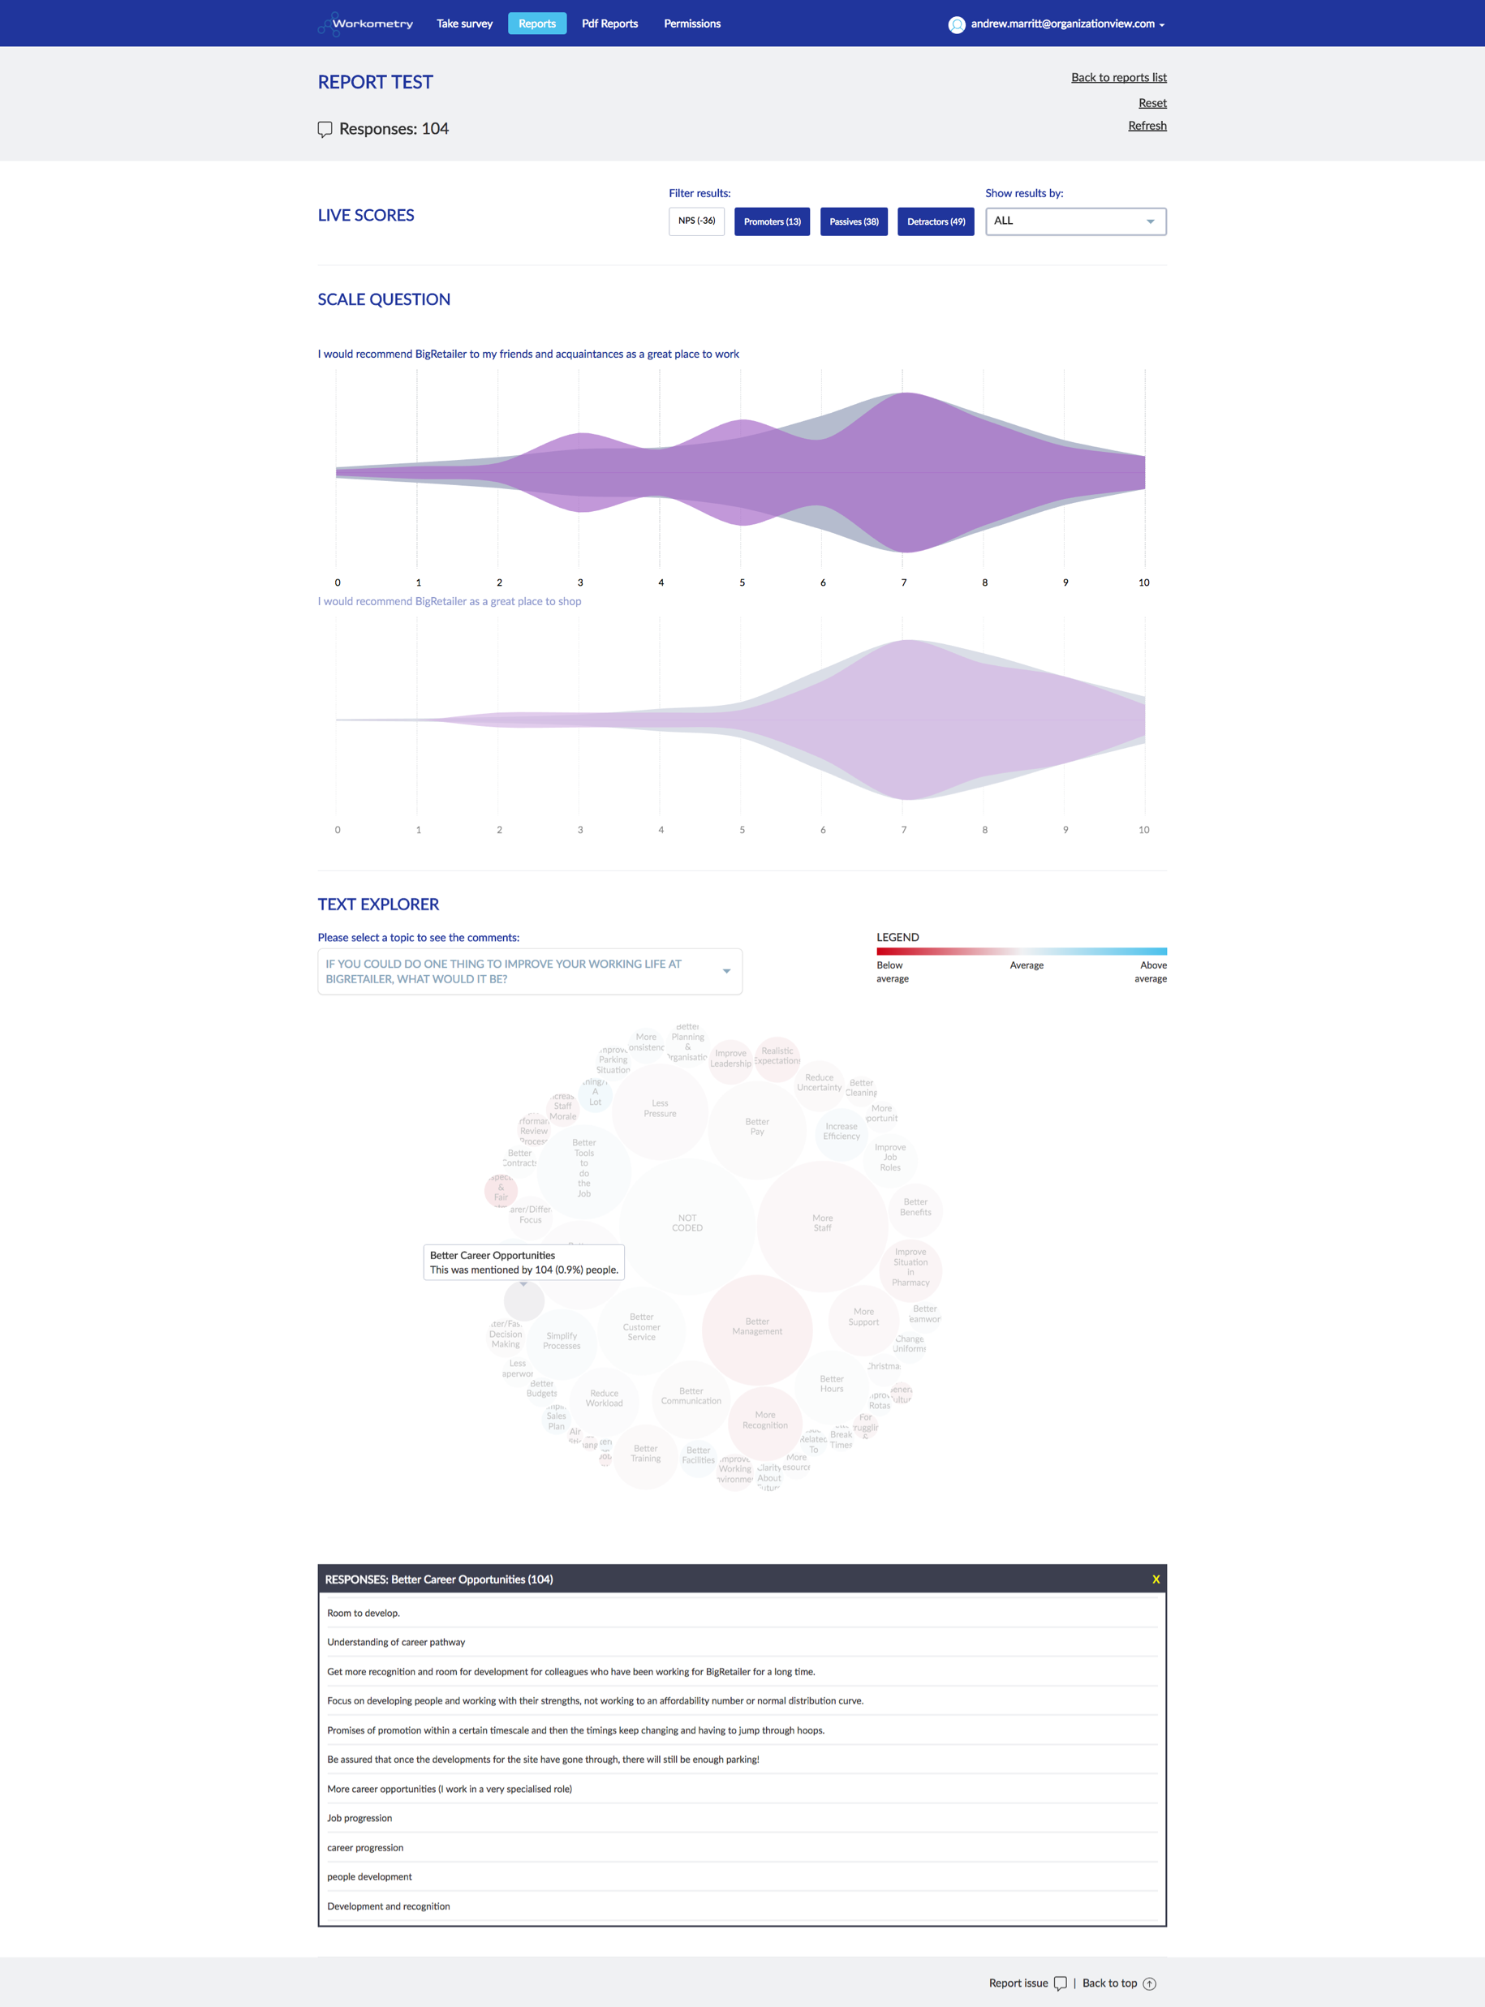
Data isn’t just numbers
Notes:
• Initial: HR teams answer oneoff
queries as and when they
happen, or to ‘fix’ something
with HR data, but no process is
documented. The terms analytics
or data probably aren’t used,
and there are no specific data or
analytics capabilities embedded
in HR teams.
• Repeatable: HR teams have
a process in place to run
analytics, and document queries
so they can be repeated. No
specific analyst role exists; it
is something that is done by
members of the HR team.
• Defined: HR analytics is a role
and/or activity in the HR team,
and the process of developing
and running analytics is well
documented and standardised.
There aren’t standardised metrics
across the business, but HR
is able to use its own data to
answer queries and run analytics.
• Managed: HR analytics team has
developed standard measures
and metrics which have been
agreed internally. A management
and governance role is in place
to ensure that analytics is
business-focused and robust.
• Optimising: analytics is
increasingly predictive, and is
being used to inform both HR
and business strategy, including
the optimisation of business
and people/HR processes. HR
data is used to drive

Slide 16
Getting started
Start small
Focus on high-impact business issue
Utilize analytics expertise outside HR
Choose easy-to-analyse groups
Benefit for employee as well as employer

Slide 17

Questions

Slide 18
Inspired Conference
Putting data and analytics at the heart of your People decisions
Date: Wednesday 7th June 2017
Presenters: David Balls (Human Resources Director – Grosvenor Casinos)
Andrew Marritt (Owner – OrganisationalView)

